Slide 1
SIG API Machinery Update
Joe Betz, Google
@jpbetz

Slide 2
Agenda
API Machinery Overview
1.33 Updates
Future Plans
Getting Involved

Slide 3
API Machinery Overview

Slide 4
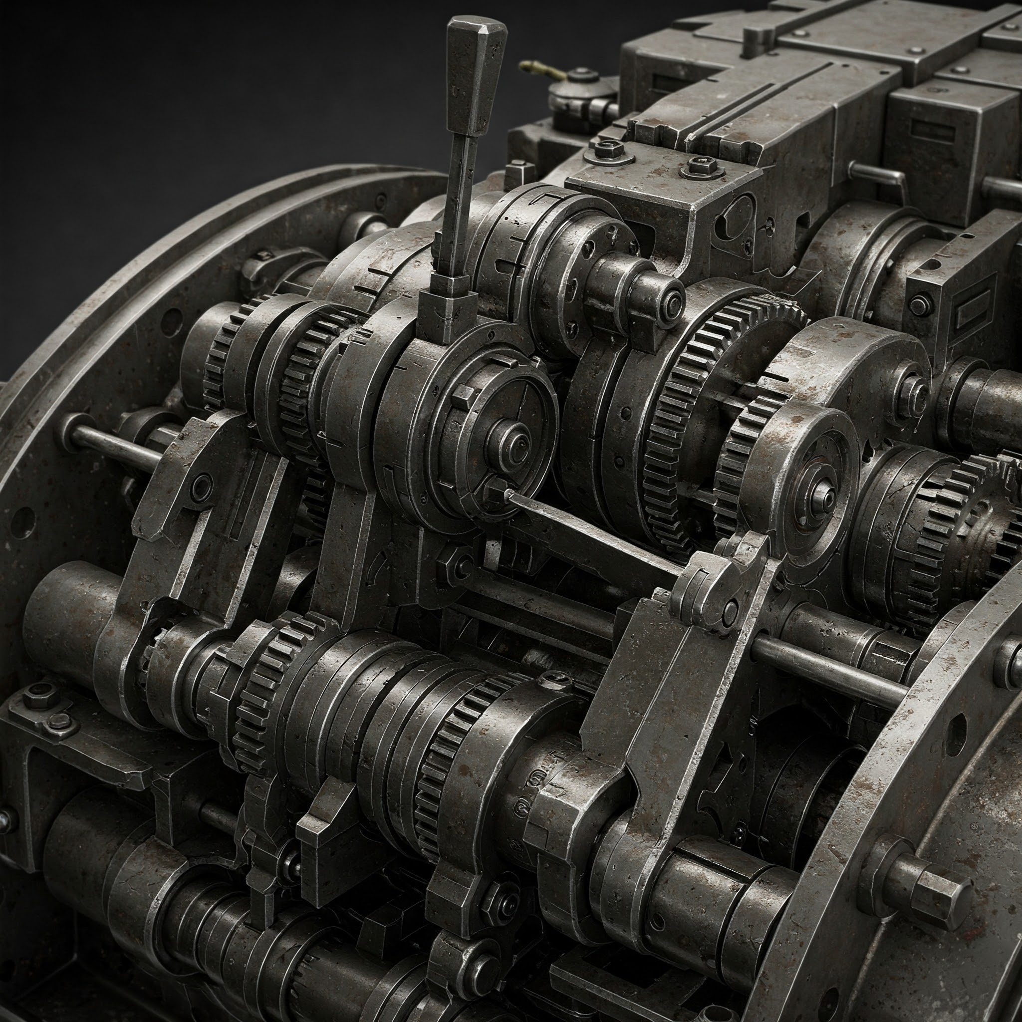
API Machinery
API Handling
REST mechanics
Versioning
Serialization (JSON, YAML, Proto, CBOR)

Slide 5
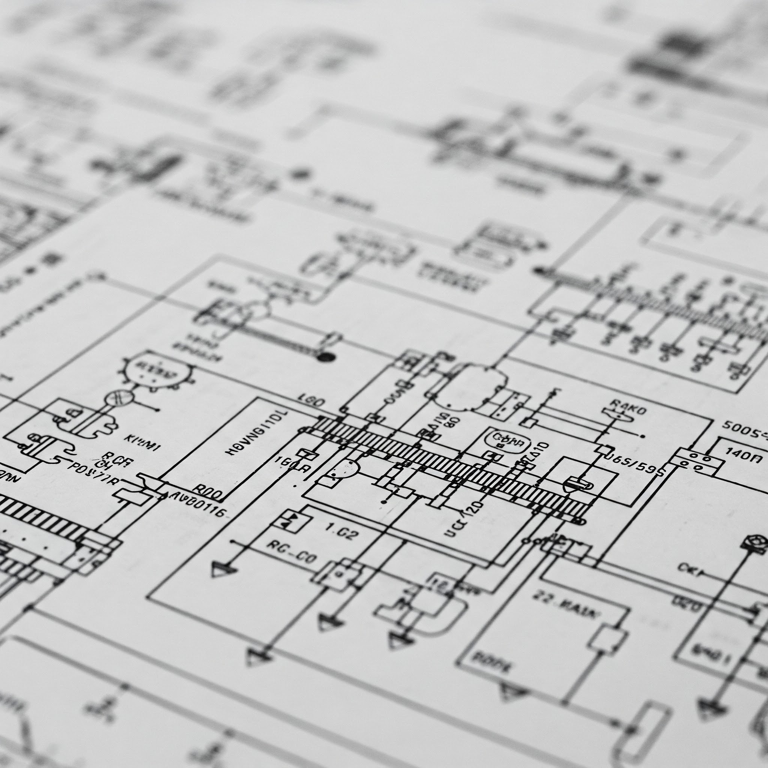
API Machinery
Resource Definitions / KRM
How built-in types and CRDs are defined
Validation, Defaulting, Conversion, Apply and Patch, Subresources, …

Slide 6
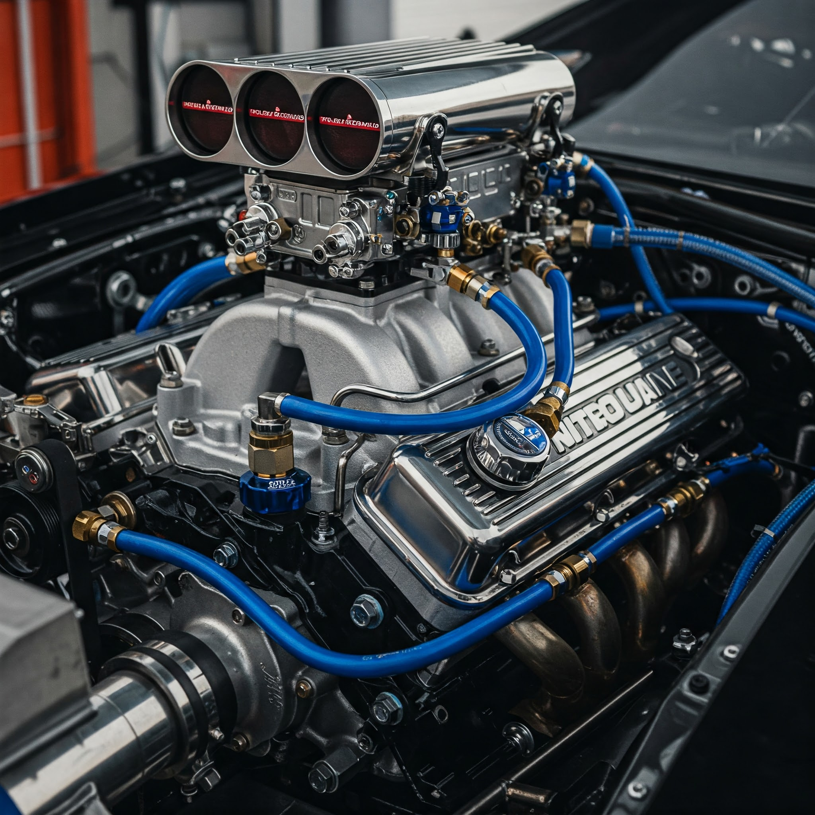
API Machinery
Extensibility
Custom Resources (CRDs, Aggregated API Servers)
Admission control
Inline logic (CEL)

Slide 7

API Machinery
Language Clients
Typed and Dynamic
Discovery
Controller Infrastructure
Controller Managers
Informers

Slide 8
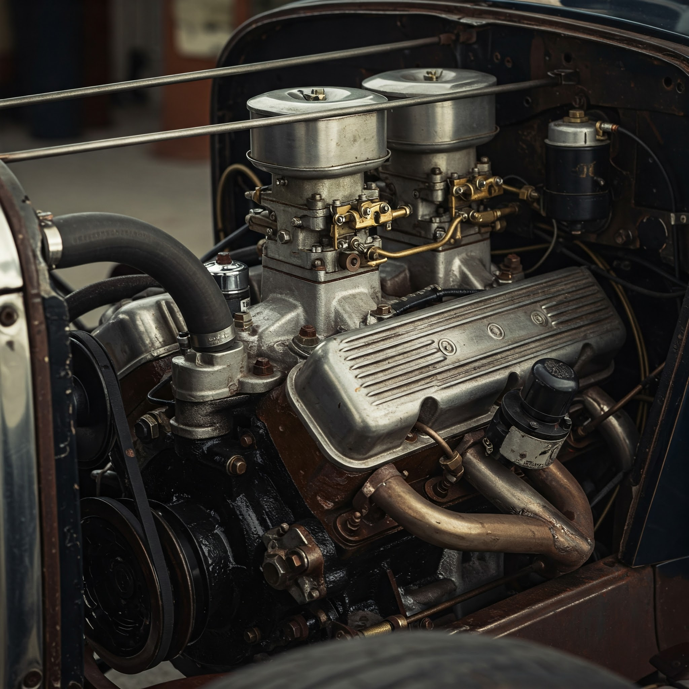
API Machinery
Reliability, Scale, Performance
…of API Servers and Controllers

Slide 9
API Machinery
API Machinery is NOT:
Not responsible for API review (@api-reviewers)
Not the owner of all APIs (owned by respective SIGs)
Not the owner of all controllers (owned by respective SIGs)
Not owner of kubectl (owned by SIG CLI)
Not owner of etcd (owned by SIG etcd)
Notes:
Why Policies? [Andy, 5 mins]
Kubernetes Policy Types [Joe, 8 mins]
Gatekeeper [Rita, 8 mins]
Kyverno [Rita, 8 mins]
Guidance & Summary [Andy, 5 mins]

Slide 10
1.33 Update

Slide 11
Kubernetes 1.33
New Alphas:
KEP-5080: Ordered namespace deletion
KEP-4988: Snapshottable API server cache
In-development Alphas:
KEP-4330: Emulation Version
KEP-4020: Mixed Version Proxy
KEP-4222: CBOR Serializer
Beta:
KEP-5073: Declarative Validation
KEP-4355: Coordinated Leader Election
KEP-5116: Streaming Encoding for LIST Responses
GA:
KEP-4008: CRD Validation Ratcheting
Title

Slide 12
Kubernetes 1.33
KEP-5080: Ordered namespace deletion
The resources associated with this namespace are deleted in order:
Delete all pods in the namespace (in an undefined order).
Wait for all the pods to be stopped or deleted.
Delete all the other resources in the namespace (in an undefined order).
Alpha
Feature gate: OrderedNamespaceDeletion
@cici37, @thockin

Slide 13
Kubernetes 1.33
KEP-4988: Snapshottable API server cache
The kube-apiserver's caching mechanism (watchcache) efficiently serves requests for the latest observed state. However, LIST requests for previous states, either via pagination or by specifying a resourceVersion, bypass the cache and are served directly from etcd.his significantly increases the performance cost, and in aggregate, can cause stability issues. This is especially pronounced when dealing with large resources, as transferring large data blobs through multiple systems can create significant memory pressure. This document proposes an enhancement to the kube-apiserver's caching layer to enable efficient serving all LIST requests from the cache.
Alpha
Feature gate: ListFromCacheSnapshot
@serathius

Slide 14
Kubernetes 1.33
KEP-4330: Emulation Version
Introduce a --emulation-version flag to emulate the capabiliites (APIs, features, ...) of a prior Kubernetes release version. When used, the capabilities available will match the emulated version. Any capabilities present in the binary version that were introduced after the emulation version will be unavailable and any capabilities removed after the emulation version will be available. This enables a binary version to emulate the behavior of a previous version with sufficient fidelity that interoperability with other system components can be defined in terms of the emulated version.
Alpha
Feature gate: --emulation-version flag
@siyuanfoundation, @jefftree, @aaron-prindle, @yongruilin

Slide 15
Kubernetes 1.33
KEP-4020: Mixed Version Proxy
When a cluster has multiple apiservers at mixed versions (such as during an upgrade/downgrade or when runtime-config changes and a rollout happens), not every apiserver can serve every resource at every version.
To fix this, we will add a filter to the handler chain in the aggregator which proxies clients to an apiserver that is capable of handling their request.
Alpha
Feature gate: UnknownVersionInteroperabilityProxy
@richabanker

Slide 16
Kubernetes 1.33
KEP-4222: CBOR Serializer
Kubernetes API servers and clients will support the Concise Binary Object Representation (CBOR) data format. CBOR will be available to clients as an alternative to JSON for serializing resources in request and response bodies. It will supersede JSON in apiextensions-apiserver for storage serialization of custom resources.
Alpha
Feature gate:CBORSerializer
@bluddy

Slide 17
Kubernetes 1.33
KEP-5073: Declarative Validation
Kubernetes Developers declare validation rules using Interface Definition Language (IDL) tags in the types.go files that define the Kubernetes native API types. For example:
type ReplicationControllerSpec struct {
// +default=1
// +k8s:optional
// +k8s:minimum=0
Replicas *int32 ``json:"..." protobuf:"..."
}
Beta
Feature gate: DeclarativeValidation
@thockin, @jpbetz, @aaron-prindle, @yongruilin

Slide 18
Kubernetes 1.33
KEP-4355: Coordinated Leader Election
This proposes a component leader election mechanism that is safer for upgrades and rollbacks.
This leader election approach continues to use leases, but with two key modifications:
Instead of a race by component instances to claim the lease, component instances declare candidacy for a lease and a election coordinator claims the lease for the best available candidate. This allows the election coordinator to pick a candidate with the lowest version to ensure that skew rules are not violated.
The election coordinator can mark a lease as "end of term" to signal to the current leader to stop renewing the lease. This allows the election coordinator to preempt the current leader and replace it with a better one.
Beta
Feature gate: CoordinatedLeaderElection
@jefftree

Slide 19
Kubernetes 1.33
KEP-5116: Streaming Encoding for LIST Responses
This KEP proposes implementing streaming encoding for collections (responses to list) that are served by the Kubernetes API server. Existing encoders marshall response into one block allocating GBs of data and keeping it until client reads the whole response. For large LIST responses, this leads to excessive memory consumption in the API server. Streaming the encoding process can significantly reduce memory usage, improving scalability and cost-efficiency.
Beta
Feature gate: StreamingCollectionEncodingToJSON, StreamingCollectionEncodingToProtobuf
@serathius

Slide 20
Kubernetes 1.33
KEP-4008: CRD Validation Ratcheting
Allows updates to custom resources that fail validation to succeed if the validation errors were on unchanged fields.
That is, an update will only fails validation due to fields that are changed by the update.
This can help manage the risk of tightening or loosening validation.
GA in v1.33 Beta and on-by-default since v1.30
@alexzielenski, @yongruilin

Slide 21
Future Plans

Slide 22
Future Plans
Safer Upgrades
Control plane upgrades should be safe, easy
Generally make it a process that cluster admins trust
Supporting KEPs:
KEP-4355: Coordinated Leader Election
KEP-4330: Emulation Version
KEP-4020: Mixed Version Proxy
Notes:
https://github.com/kubernetes/enhancements/issues/4330
https://github.com/kubernetes/enhancements/issues/4020

Slide 23
Future Plans
Declarative APIs
Declarative Validation, Defaulting, Ratcheting
KEP-5073: Declarative Validation
Improving the consistency between CRDs and built-in types
KEP-4595: AdditionalPrinterColumns with CEL
Support for more formats in CRD validation
Embedding or referencing other types
Notes:
https://github.com/kubernetes/enhancements/issues/4595

Slide 24
Getting Involved

Slide 25
Getting Involved
Kubernetes Slack: #api-machinery
Regular SIG meetings
SIG Meeting: 60 min / every 2 weeks (11 am PST, Wednesday) (playlist)
PR and Bug triage: 30 min / twice every week (1 pm PST, Tuesday - Thursday )
(join the mailing list to get the invites!)
SIG Chairs:
David Eads (@deads2k), Red Hat
Federico Bongiovanni (@fedebongio), Google
SIG Technical Leads:
David Eads (@deads2k), Red Hat
Joe Betz (@jpbetz), Google
Stefan Schimanski (@sttts), Nvidia
Notes:
Why Policies? [Andy, 5 mins]
Kubernetes Policy Types [Joe, 8 mins]
Gatekeeper [Rita, 8 mins]
Kyverno [Rita, 8 mins]
Guidance & Summary [Andy, 5 mins]

